Slide 1
OLIST SALES ANALYSIS
GROUP 2

Slide 2
agenda
Overview
Objective
Insights
Conclusion

Slide 3
Overview
A comprehensive collection of data provided by Olist, encompassing a diverse range of e-commerce transactions.
Includes information on sellers, customers, products, orders, and reviews.
Captures the intricacies of the e-commerce ecosystem, offering valuable insights into market trends, consumer behavior, and business dynamics.

Slide 4
objective
Extract meaningful insights from the dataset to inform strategic decision-making.
Understand customer preferences, optimize supply chain processes, and identify opportunities for business expansion
Leverage data-driven approaches to enhance the overall user experience for both sellers and buyers.
Implement targeted strategies to improve customer satisfaction and loyalty.

Slide 5
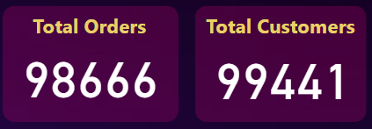
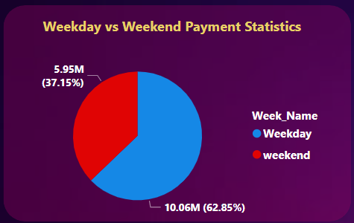
insights
In analyzing payment statistics between weekdays and weekends, we observe that weekdays comprise 10.06 million payments, constituting 62.8%, whereas weekends account for 5.95 million payments, representing 37.15%.
In the light of this data, it is advisable to make inventory adjustments to align with these patterns. Additionally, implementing strategies specifically tailored for weekend engagement would be beneficial.

Slide 6
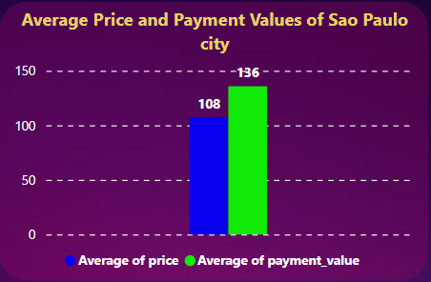
insights
In São Paulo, where the average price is 108 and the average payment value is 136, it indicates that the cost of goods or services is slightly below what consumers are willing to spend.
This favorable pricing environment may boost purchase intent.
Moreover, the higher average payment value suggests that consumers in São Paulo are generally open to spending beyond the baseline price, reflecting positive confidence and an inclination for higher-value transactions.

Slide 7
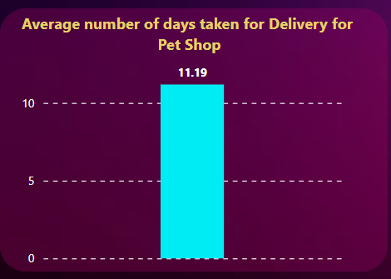
insights
With an average delivery time of 11.19 days for the pet shop, there's a potential impact on customer expectations.
It's crucial to evaluate if this duration meets customer anticipations and consider adjustments to align with or surpass those expectations.
Additionally, comparing the pet shop's delivery time to industry standards and competitors is vital.
A significantly longer delivery time may pose a competitive disadvantage, necessitating attention and improvement.

Slide 8
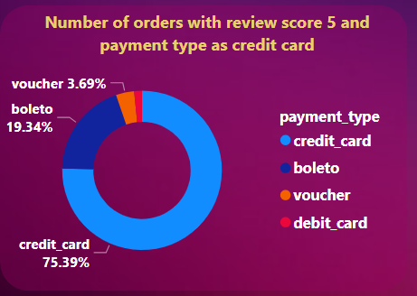
insights
Out of orders with a review score of 5, 75.39% use credit cards, 19.34% opt for boleto, 3.69% utilize vouchers, and 1.58% choose debit cards.
The dominance of credit card usage implies that promotional strategies tied to credit card payments may appeal to satisfied customers.
However, ensuring user-friendly processes for boleto, voucher, and debit card payments is crucial for accommodating a diverse customer base.

Slide 9
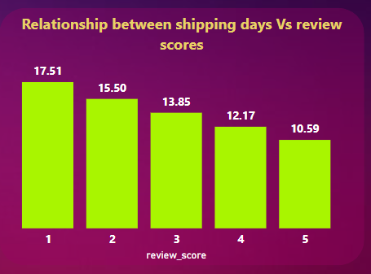
insights
Examining shipping days in relation to review scores reveals a clear trend: review score 1 orders take 17.51 days, score 2 takes 15.50 days, score 3 takes 13.85 days, score 4 takes 12.17 days, and score 5 takes 10.59 days.
This declining trend suggests that faster shipping correlates with higher customer satisfaction.
Customers assigning higher scores appear to value and appreciate timely order fulfillment, emphasizing the importance of efficient shipping processes in enhancing overall customer experience.

Slide 10
CONCLUSION
The overarching conclusion is the need for a holistic approach that considers inventory adjustments, pricing strategies, delivery efficiency, payment preferences, and the correlation between shipping speed and customer satisfaction.
Combining these insights can inform a comprehensive strategy aimed at enhancing overall business performance and customer experience.

Slide 11
Team Members
Shubhkaram Singh Thind
Chaitanya Rohidas Patil
Ranjith kumar. L
SYED ZUBAIR
Sohit
Kaif Yusuf Khan

Slide 12
THANK YOU

